Slide 1
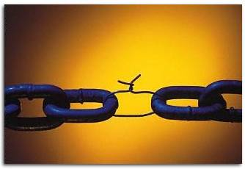
LOGICAL FALLACIES
Illogical statements that weaken arguments

Slide 2
Overview of logical fallacies
Fallacy: An argument that contains mistakes in reasoning
Fallacies may be committed intentionally, unintentionally, or for fun (jokes, memes…)
1. Fallacies of relevance (Chapter 5)
Mistakes in reasoning because the premises (fact, opinion) are logically irrelevant to the conclusion (opinion).
2. Fallacies of insufficient evidence (Chapter 6)
Mistakes in reasoning because the premises, though logically relevant to the conclusion, fail to provide sufficient evidence to support the conclusion.

Slide 3
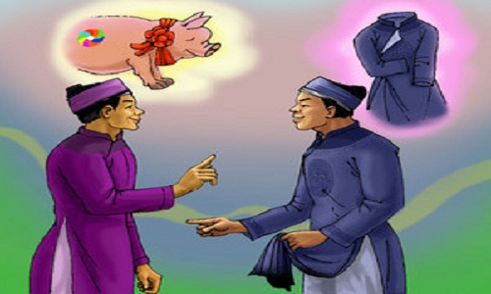
CHAPTER 5
FALLACIES OF RELEVANCE
I haven’t seen the pig since I put on this new outfit.
Do you see my pig passing by?

Slide 4
CONCEPT OF RELEVANCE
One statement is relevant to another when it provides evidence either for or against that other statement (even if it is completely false).
A statement can be:
positively relevant
negatively relevant
logically irrelevant

Slide 5
CONCEPT OF RELEVANCE (cont)
Positively relevant:
All dogs have five legs. Rover is a dog. So, Rover has five legs.
Negatively relevant:
Maggie is studying at a high school. So, Maggie is a professor.
Logically irrelevant:
The earth moves around the sun. Therefore, capital punishment must be stopped.

Slide 6
Activity: Sort them out
Carlos recently gave Amy an engagement ring. So, Carlos loves Amy.
Thousands of tobacco farm workers will lose their jobs if cigarette taxes are doubled. Therefore, smoking does not cause cancer.
Thousands of tobacco farm workers will lose their jobs if cigarette taxes are doubled. Therefore, cigarette taxes should not be doubled.
The last three coin tosses have been heads. So, the next coin toss will surely be tails.
You should believe in God. You have everything to gain if God does exist, and little to lose if He doesn’t.
Peter and his wife are both over 6 feet tall. Therefore, their daughter is likely to be over 6 feet tall, too.
Martina partied all night last night. Therefore, she will do well on her critical thinking test next week.
PR
LI
PR
NR
PR
PR
LI

Slide 7
ELEVEN FALLACIES OF RELEVANCE
1. Personal attack (Ad Hominem)
2. Attacking the motive (assumed benefits/purposes)
3. Look who’s talking (Tu Quoque)
4. Two wrongs make a right
5. Scare tactic (appeal to force)
6. Appeal to pity
7. Bandwagon argument (Appeal to popularity)
8. Straw man
9. Red herring
10. Equivocation
11. Begging the question (circular reasoning)

Slide 8
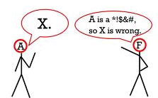
1. Personal attack (Ad Hominem)
* Attacks the person rather than the issue.
Examples:
Sam is divorced, so how can he make sound financial decisions for the city?
Mr. Spock is not an effective CEO because he has ugly pointed ears.
Dr. Smith’s books about plant genetics are worthless because he used to tell a lie at high school.

Slide 9
1. Personal attack (Ad Hominem)
Common pattern:
F: A is a bad person (in one way or another).
Therefore, his/her opinion or argument must be bad.

Slide 10
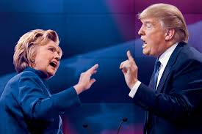
1. Personal attack (Ad Hominem)
2nd Presidential Debate (Oct, 2016)
Hillary: What we saw and heard on Friday was Donald talking about women, what he thinks about women, what he does to women. He said the video doesn’t represent who he is. But I think it’s clear to anyone who heard that it represents who he is.
Trump: If you look at Bill Clinton, far worse. Mine are words, his was action. His was what he’s done to women… And I will tell you that when Hillary brings up a point like that and she talks about words that I said 11 years ago, I thinks it’s disgraceful, and it’s ashamed of herself.
Notes:
Hillary’s premise: What we saw and heard on Friday was Donald talking about women, what he thinks about women, what he does to women.
Hillary’s conclusion: But I think it’s clear to anyone who heard that it (what Trump thinks and does to women) represents who he is.
Trump: If you look at Bill Clinton, far worse. Mine are words, his was action. His was what he’s done to women…
-> Personal attack: Instead of arguing against Hillary’s argument, Trump attacked her husband.

Slide 11
2. Attacking the motive
Common pattern:
X is biased or has questionable motives.
Therefore, X’s argument or claim should be rejected.
Example:
Mr. X said that our company cannot downsize the staff because we need a strong labor force. Why should we listen to him? With his sick leave of 2 months, he will surely be on top of the dismissal list.
Notes:
A motive is a inferred purpose of a person’s action.
Attacking the motive is a specific type of personal attack.

Slide 12
2. Attacking the motive
* Criticizes the arguer’s motivation.
Examples:
The president of Student Affairs Department had a speech to persuade all students to take a bus to school to protect the Earth. I don’t know if he wants to protect the Earth, or is it because his father is a bus driver?
2. Linda suggested that class attendance should not be checked daily because adult students cannot be managed like children. Why should the teacher listen to her, a regularly late student last year?

Slide 13
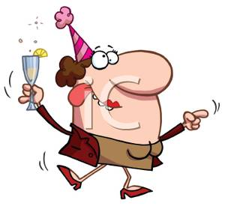
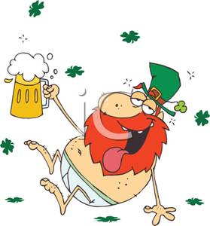
3. Look who’s talking (Tu Quoque)*
Common pattern:
X fails to follow his or her advice.
Therefore, X’s argument or claim should be rejected.
You drink day and night. You should stop drinking to improve your health.
Good advice from a man with a glass of wine in his hand! Why shouldn’t you stop drinking?
.
A
B
Tu Quoque*: And you, too.
Notes:
This type of fallacy is based on a poor analogy: two people have different situations, but the arguer tries to equate them.
In the example, A gives B advice, maybe because B drinks too much and is having health problems. Instead of arguing back on these two points, B points out that A is drinking, too.
The thing is maybe A is drinking but not a heavy drinker like B, or A does not have any health problems like B.

Slide 14
3. Look who’s talking (Tu Quoque)*
* Attacks the arguer because (s)he fails to practice what (s)he preaches.
Example:
A: You are hanging out too much. How can you have
good exam results?
B: Hey, who said hello to me at the bar last night? It was you, I suppose?
Notes:
B argues back with the assumption that A also hangs out too much, but it’s not necessarily the case. B just stopped by once, and B does not take any exam. -> B’s counter-argument is not relevant to A’s conclusion regarding A’s good exam results.

Slide 15
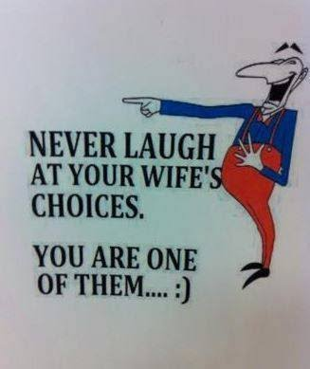
3. Look who’s talking (Tu Quoque)*
* Attacks the arguer because (s)he fails to practice what (s)he preaches.
Example:
There may be a conversation like this:
My wife has a poor taste. She always chooses wrong clothing items.
Never laugh at your wife’s choices. You are one of them!
Natural Solutions Magazine
Notes:
In B’s counter-argument, the choice of husband is not relevant to the choices of clothing items. Hidden in this is the implication ‘you made a poor choice of her, too’

Slide 16
4. Two wrongs make a right
Justifies a wrongful act by claiming others are bad or worse.
Common pattern:
I did what the other did.
So I didn’t do anything wrong.
Example:
Student: Teacher, you can’t punish me for cheating on
your test. The student next to me also cheated. Why me?
Notes:
This is an informal fallacy that occurs when assuming that, if one wrong is committed, then another wrong will cancel it out.
In the example, the student tries to justify his/her wrong doing by claiming the other already did the same wrong thing.

Slide 17
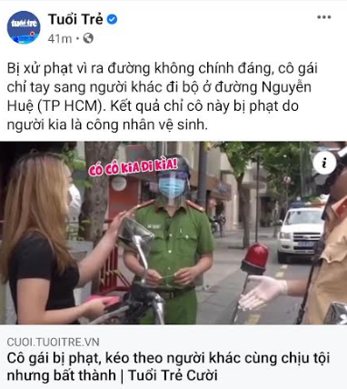
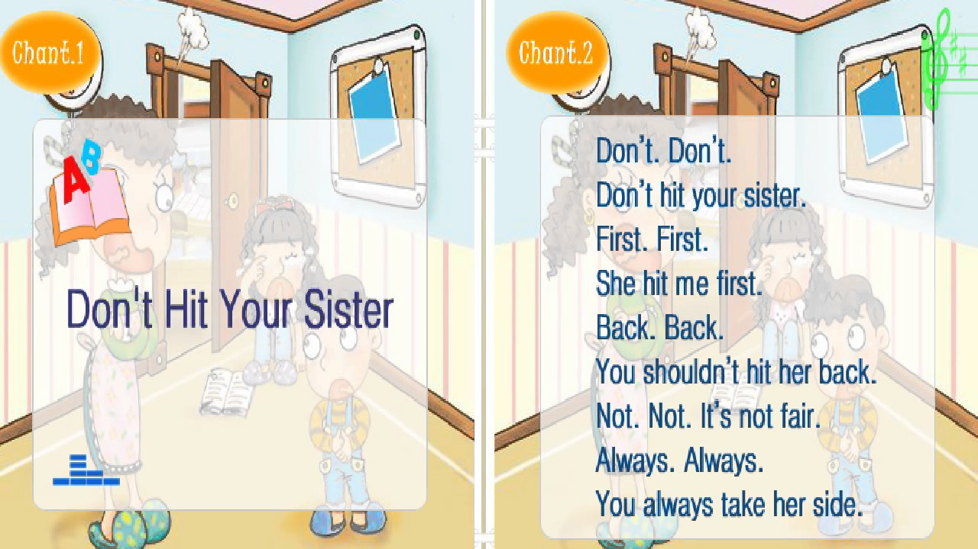
4. Two wrongs make a right
Look at the woman going over there!
A girl being fined by the police for going out without a good reason

Slide 18
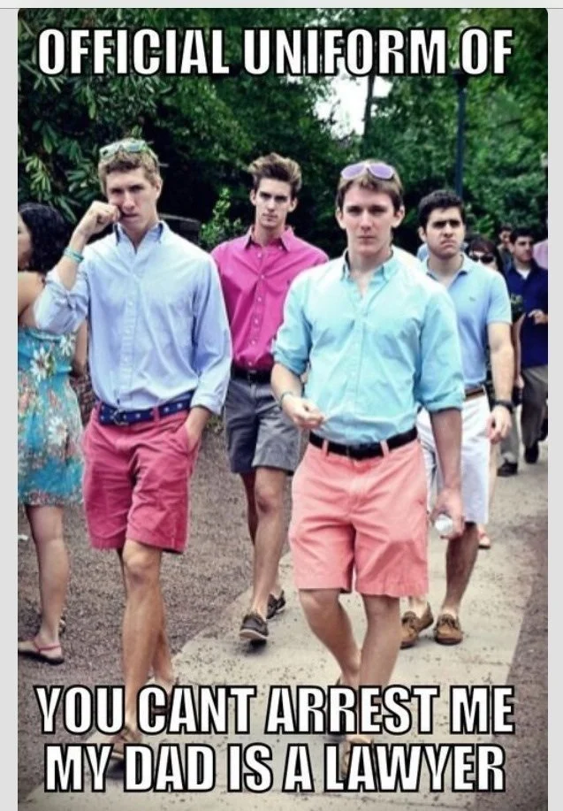
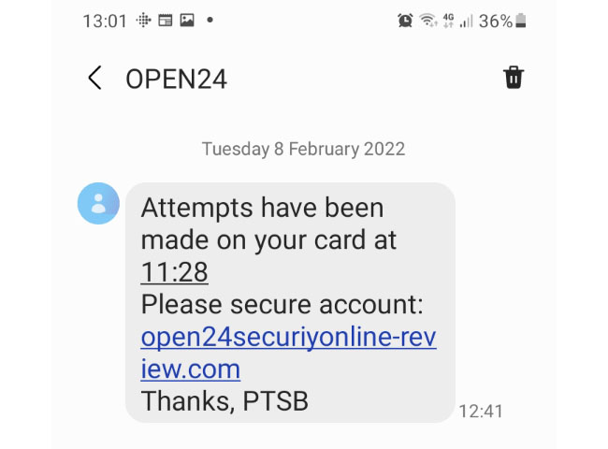
5. Scare tactic (appeal to force)
Threatens to harm the listener if conclusion not accepted; this threat is irrelevant to arguer’s conclusion.
Examples:

Slide 19
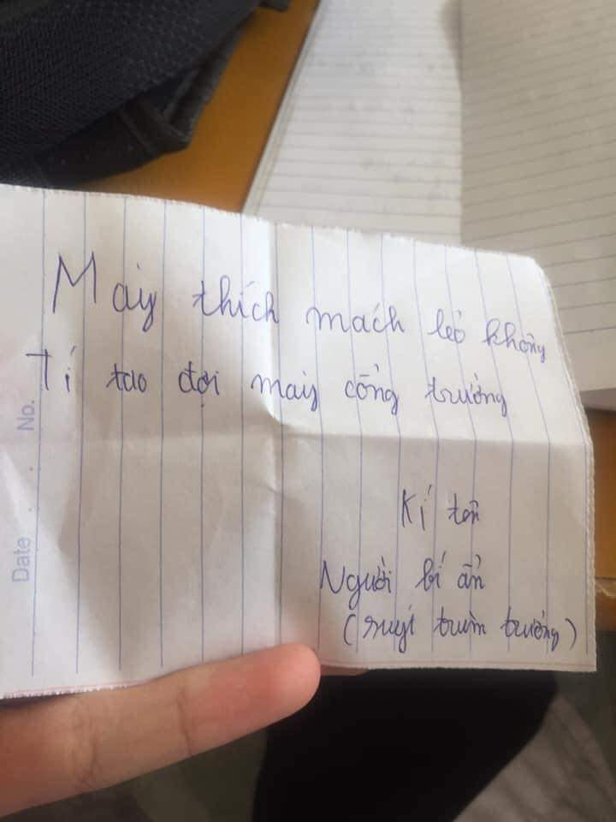
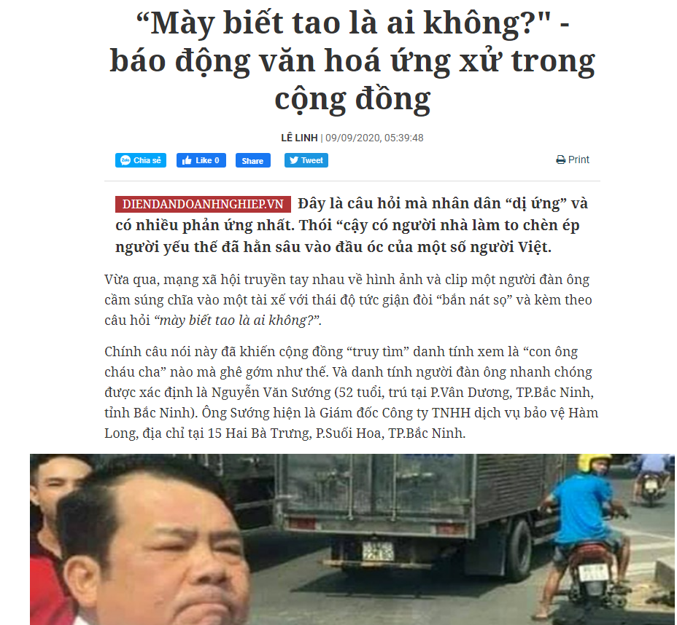
5. Scare tactic (appeal to force)
Threatens to harm the listener if conclusion not accepted; this threat is irrelevant to arguer’s conclusion.
Examples:
Wrong doer: Do you know who I am?
Do you want to report things to our teacher? I’ll wait for you at the school gate in a moment.
Signed
Mysterious
(An almost school gang leader)

Slide 20
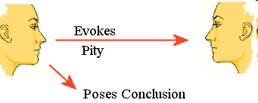

6. Appeal to pity
Inappropriately appeals to feelings of pity from the listener or reader.
Examples:
1.
2. Student: Teacher, I hope you won’t be hard enough to prohibit me from taking the exam because of my frequent absences. I lost all the money my parents gave for one month’s food, and my girlfriend left me for a more handsome man. I was so upset!

Slide 21
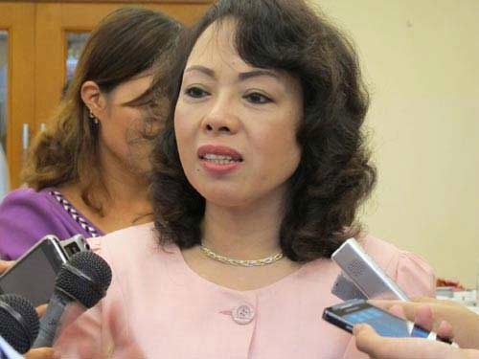
6. Appeal to pity
Chúng tôi cảm nhận sâu sắc về vấn đề đạo đức ngành y, hy vọng các đại biểu và nhân dân nhìn nhận khoan dung với chúng tôi. Một năm ngành y khám bệnh cho 121 triệu lượt người, một con số lớn như thế nên không thể tránh khỏi những sơ xuất.” (NewsZing, Nov, 2013)
Example 4
Ex-minister of Health: We well perceive medical ethics. I hope governmental representatives and people to be tolerant toward us. Every year, we have to cure as many as 121 million patients, so mistakes are unavoidable.”

Slide 22
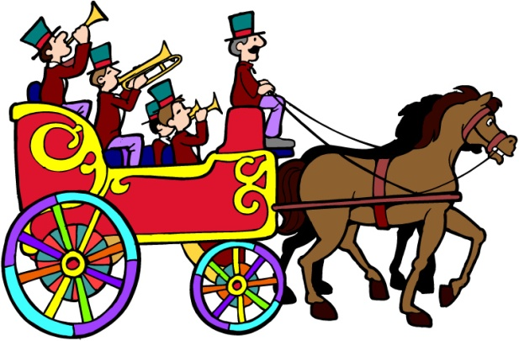
7. Bandwagon argument (Appeal to popularity)
Common pattern:
Everybody (or a majority group) does X.
Therefore, you should believe in, or do X, too.

Slide 23
7. Bandwagon argument (Appeal to popularity)
Makes a claim due to arguer’s desire to be popular or valued rather than appealing to logically relevant evidence.
Examples:
Student: Look at those trendy students with dyed hair and nose rings! You must change your style right away!
A’s friend: I can’t believe you are doing homework on Saturday night while many others are partying! Go out and enjoy yourself!

Slide 24
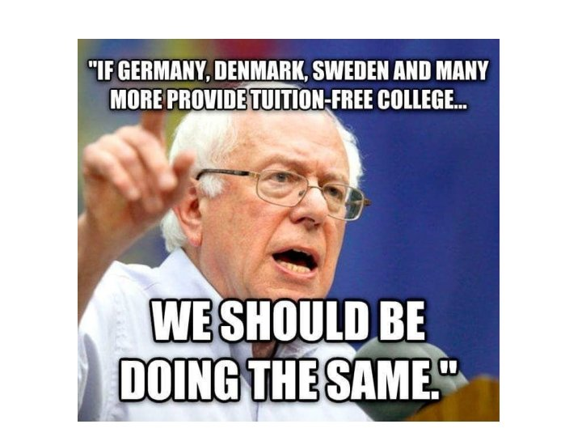
7. Bandwagon argument (Appeal to popularity)
Example 3

Slide 25
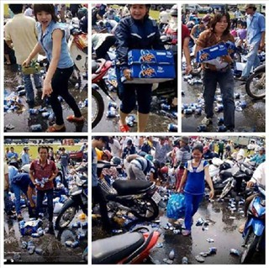
7. Bandwagon argument (Appeal to popularity)
Example 4
Looter 1: I saw the beer cans ‘un-possessed’, so I looted some like others.
Looter 2: “Actually, I picked up the beer with the crowd psychology, not thinking that I was looting.”
Beer looting in Đồng Nai, 2014
1. Lúc ấy tôi thấy bia “vô chủ”, nhiều người lấy nên cũng vô tư làm theo.
2. Thực sự tôi nhặt bia với tâm lý đám đông chứ không nghĩ mình đang hôi của.)

Slide 26
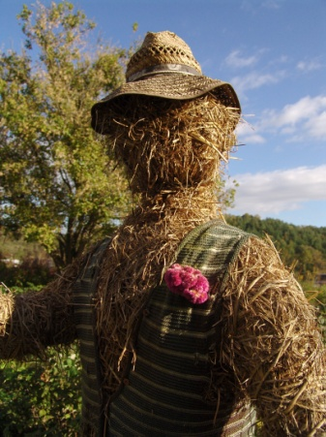
8. Straw man
Common pattern:
X’ view is false or unjustified (but it is misinterpreted).
Therefore, X’s view should be rejected.
Example 1:
Evolution is false! How could a mouse evolve into an elephant?

Slide 27
8. Straw man
misrepresents the original argument to attack the arguer easily
Example 2:
Bob: I feel sick this morning and I have to stay home. I must ask the teacher to make up the test next week.
Bill: You don’t feel like taking the test today and you demand another chance? No way!
Notes:
Bob does not say he doesn’t feeling like taking the test today; Bill adds it up to attack Bob.

Slide 28
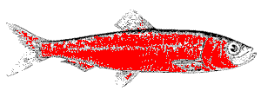
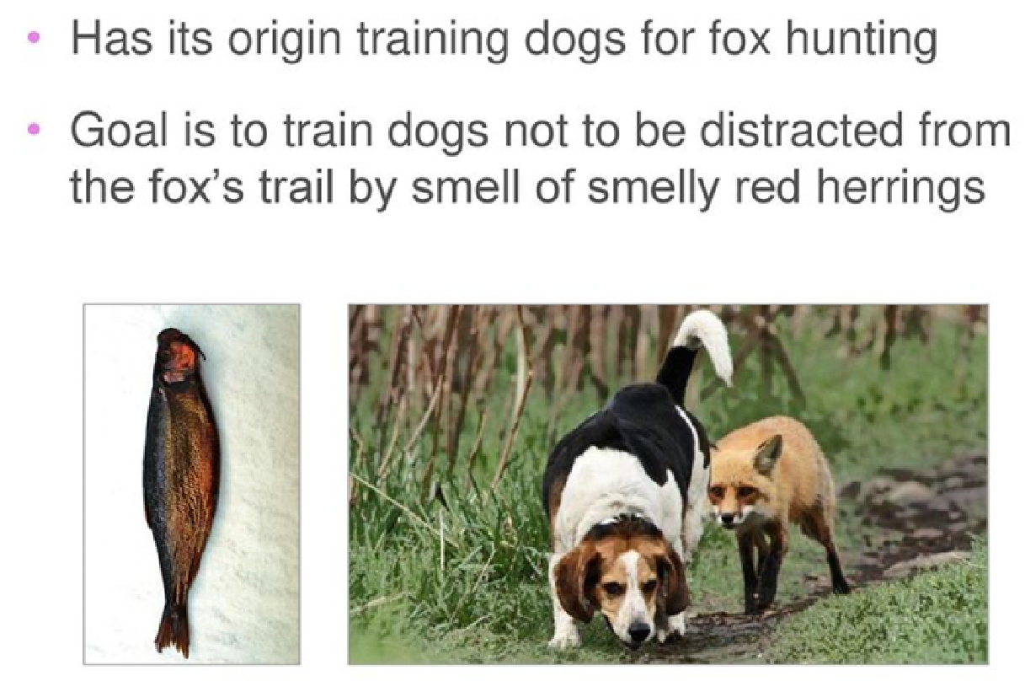
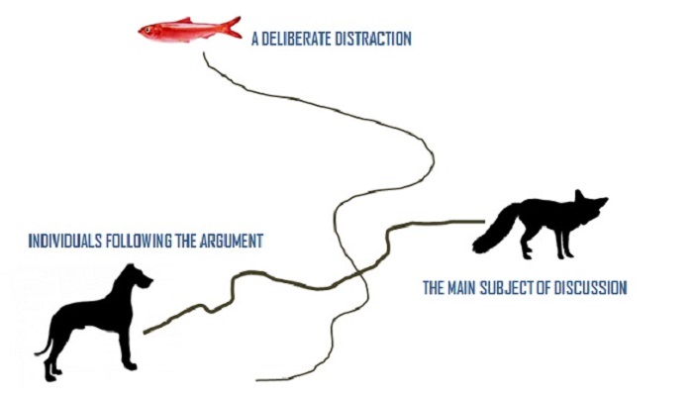
9. Red herring

Slide 29
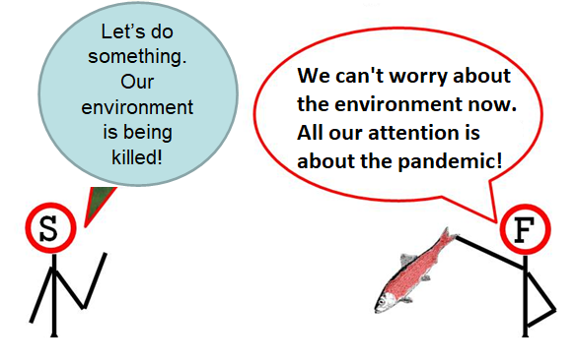
9. Red herring
draws attention away from the original point
Example:
You’re not being fair by denying me the opportunity to have a make-up test. I’m paying for this course!
2.

Slide 30
9. Red herring
draws attention away from the original point
Example: 2nd Presidential Debate, (October, 2016)
COOPER: You described kissing women without consent. That is sexual assault. You bragged that you have sexually assaulted women. Do you understand that?
TRUMP: No, I didn’t say that at all. I don’t think you understood what was - this was locker room talk. I’m not proud of it. I apologize to my family… You know, when we have a world where you have ISIS chopping off heads, where you have - and, frankly, drowning people in steel cages, where you have wars and horrible, horrible sights all over, where you have so many bad things happening, this is like medieval times. Yes, I’m very embarrassed by it. I hate it. But it’s locker room talk, and it’s one of those things.

Slide 31
9. Red herring
draws attention away from the original point.
Example: 2nd Presidential Debate, (October, 2016)
COOPER: You described kissing women without consent. That is sexual assault. You bragged that you have sexually assaulted women. Do you understand that?
TRUMP: No, I didn’t say that at all. I don’t think you understood what was - this was locker room talk. I’m not proud of it. I apologize to my family… You know, when we have a world where you have ISIS chopping off heads, where you have - and, frankly, drowning people in steel cages, where you have wars and horrible, horrible sights all over, where you have so many bad things happening, this is like medieval times. Yes, I’m very embarrassed by it. I hate it. But it’s locker room talk, and it’s one of those things.

Slide 32
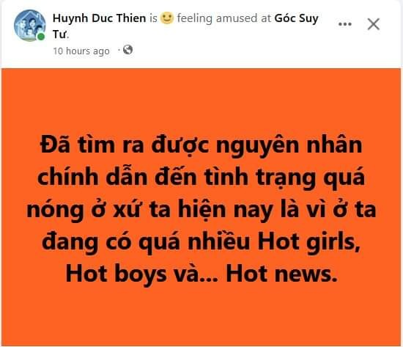
10. Equivocation
key words used in two or more senses in the same argument
Examples:
A: “I really get sick with those hot dogs.”
B: “Yeah, it’s really hot now. Give them a bath and you’ll see they’re lovely!”

Slide 33
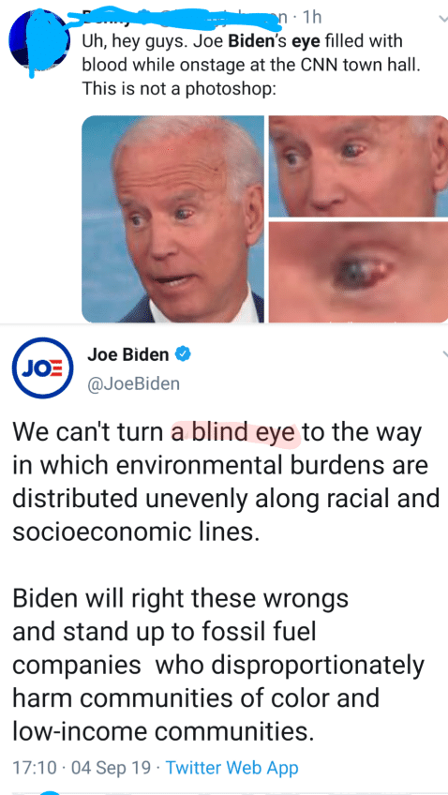
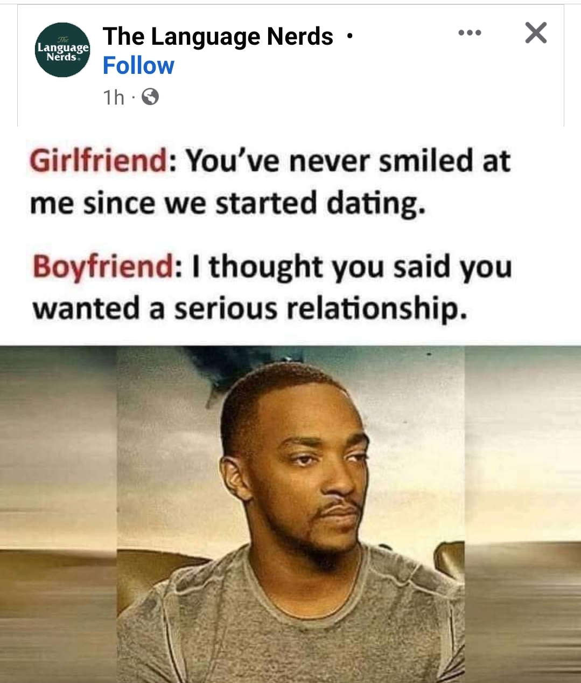
10. Equivocation
Notes:
https://me.me/i/n-1h-uh-hey-guys-joe-bidens-eye-filled-with-4e2c6bd6917947e2b2ccc13b2600caeb

Slide 34
11. Begging the question (circular reasoning)
simply restates the conclusion or argues in a circle
Examples:
Bungee-jumping is dangerous because it’s unsafe.
2. Capital punishment is morally wrong because it is ethically impermissible to inﬂict death as punishment for a crime.
3. Kylie: God wrote the Bible.
Ned: How do you know?
Kylie: Because it says so in the Bible, and what the Bible
says is true.
Ned: How do you know what the Bible says is true?
Kylie: Because God wrote the Bible.
Notes:
This type of fallacy is committed when the arguer does not have relevant and appropriate premise(s) for the conclusion. Instead, the arguer uses a synonym or a paraphrase to repeat the point, or to go a long way and get back to the starting point.

Slide 35
Student’s contribution
A: Ms. Ngoc's quizzes are difficult.
B: Why are they difficult?
A: Because the questions are not easy.
Fallacy type: Begging the question
Source: Giang Dao

Slide 36
YOUR TURN
FALLACY OR NOT FALLACY?

Slide 37
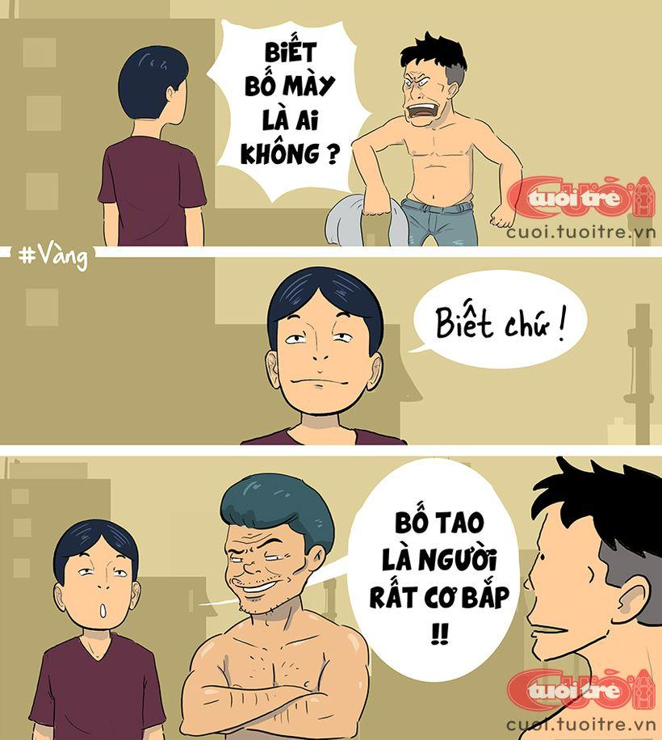
FALLACY OR NOT FALLACY?

Slide 38
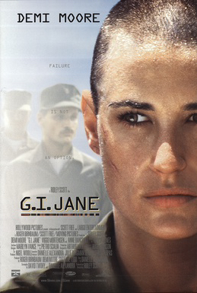
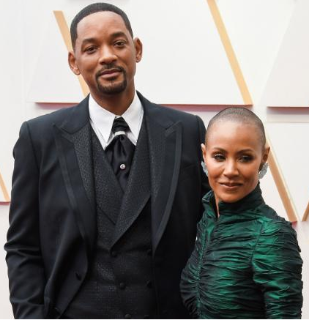
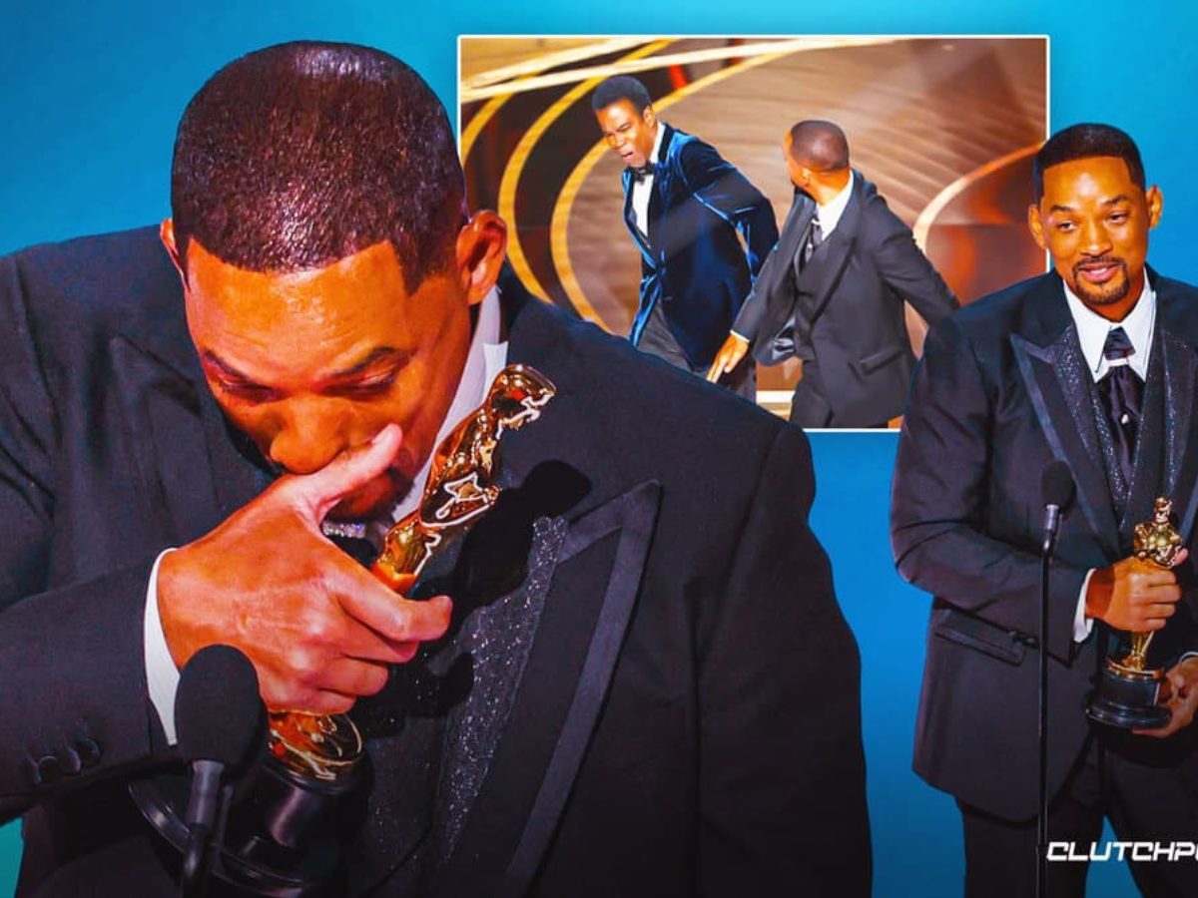
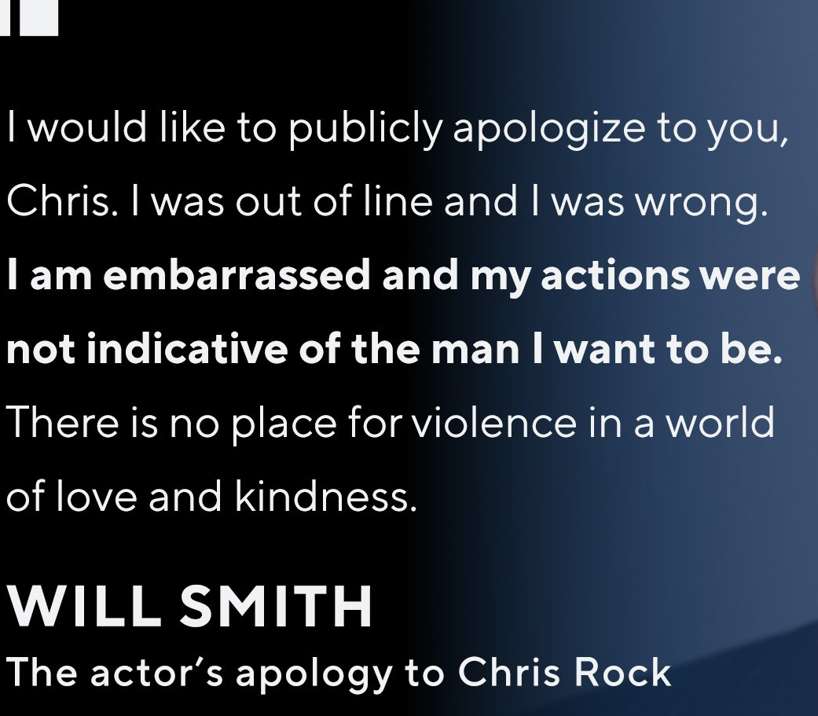
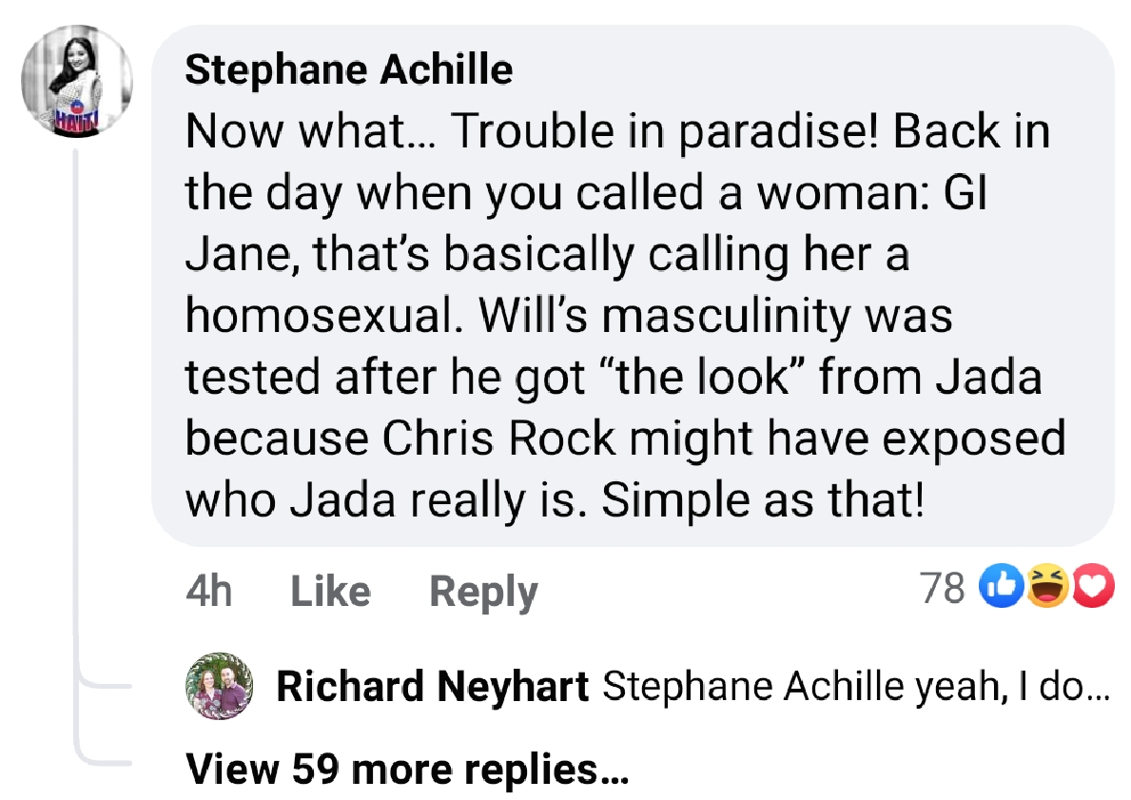
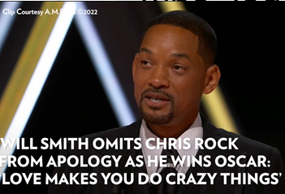
The Oscars Slap (March 27, 2022)
Chris Rock: "Jada I love you, 'G.I. Jane 2,' can't wait to see it,"
Will Smith: “Leave my wife's name out of your f**king mouth."
Notes:
Chris Rock: weak analogy
Will Smith: two wrongs make a right
Stephanie Achille: strawman
https://edition.cnn.com/2022/03/28/entertainment/chris-rock-will-smith-charges-intl-scli/index.html

Slide 39
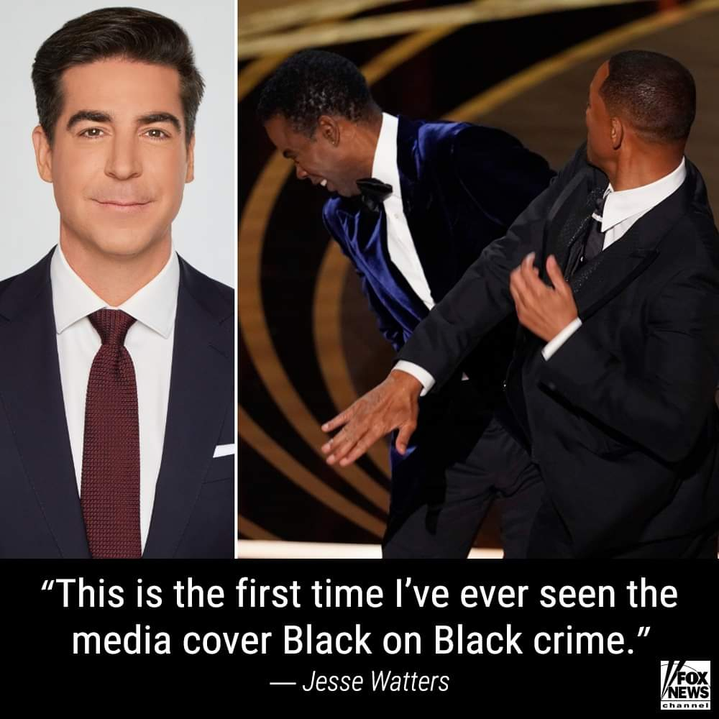
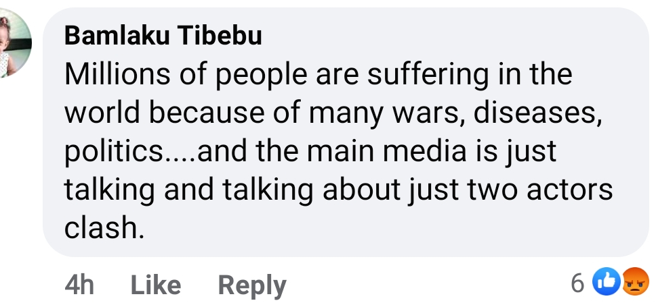
FALLACY OR NOT FALLACY?
“This is the first time I’ve ever seen the media cover black-on-black crime, so I’m actually quite surprised by this,” Watters said.
Fox News host Jesse Watters
Notes:
A slap turned into a crime: red herring
A poor joke + inappropriate reaction turned into racism: herring
Bamlaku Tibehu mentions other topics (wars, diseases…) not related to this thread: Red herring
Bamlaku Tibehu blaims/attacks the main media “is just talking and talking about just two actors” while this topic is just one among many other posts on the main media: strawman
https://www.mediaite.com/tv/jesse-watters-says-will-smith-slap-is-first-time-ive-seen-the-media-cover-black-on-black-crime/

Slide 40
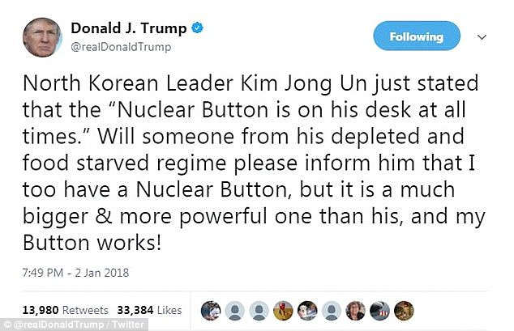
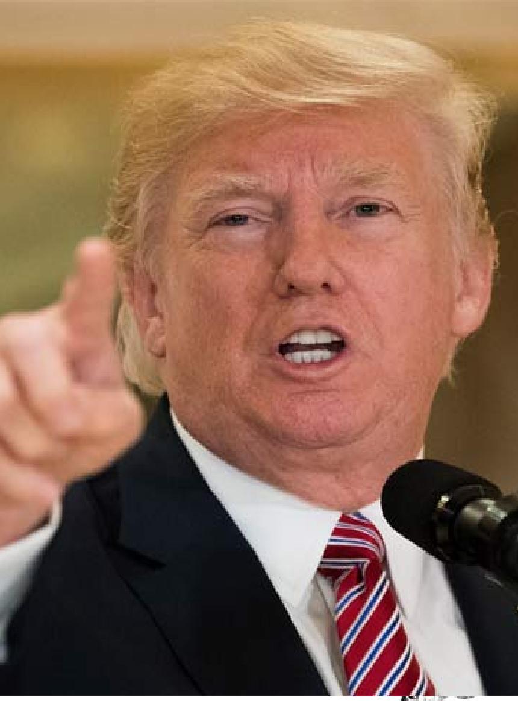
How many fallacies can you find?
Notes:
- Personal attack: … his depleted and starved regime
Scare tactic: much bigger & more powerful than his, and mine works!
For peace lovers, there may be one more fallacy: Kim Jong Un threatens the world (1st wrong) and Donald Trump also threatens back: two wrongs make a right

Slide 41
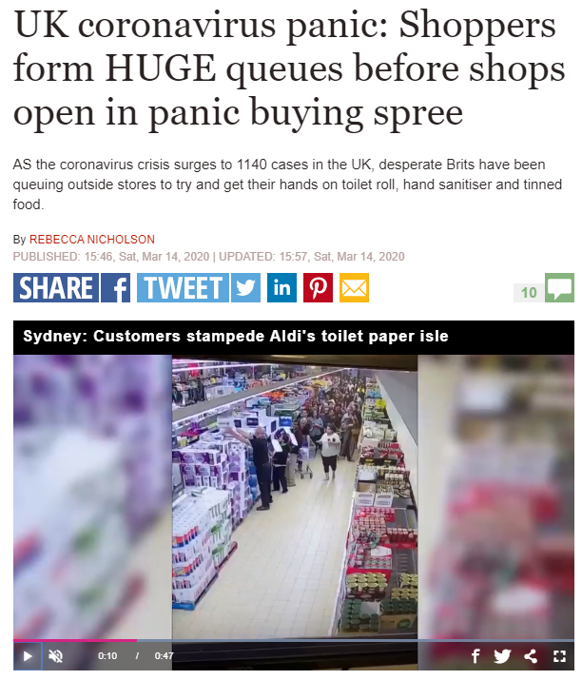
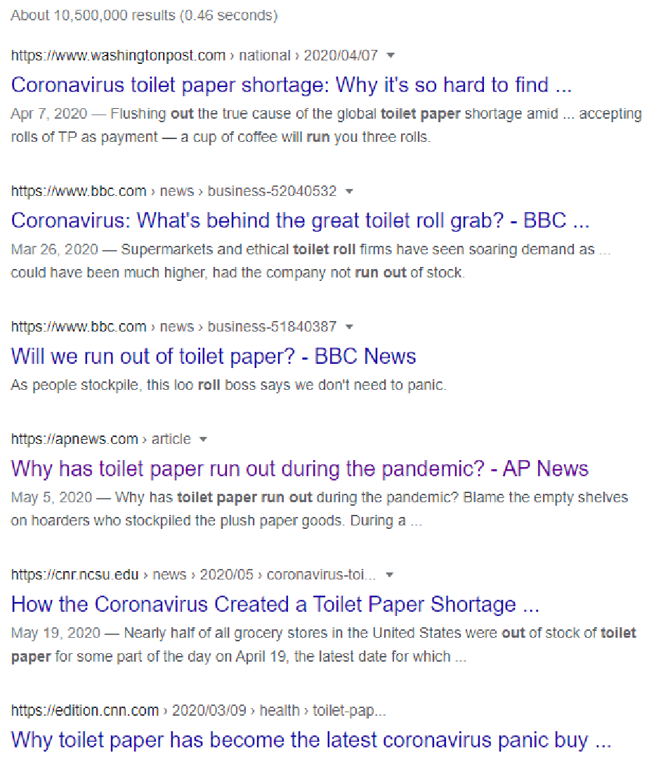
Which fallacy is it?
Notes:
https://www.express.co.uk/news/uk/1255270/uk-coronavirus-panic-buying-shops-huge-queues-shortages-pictures

Slide 42
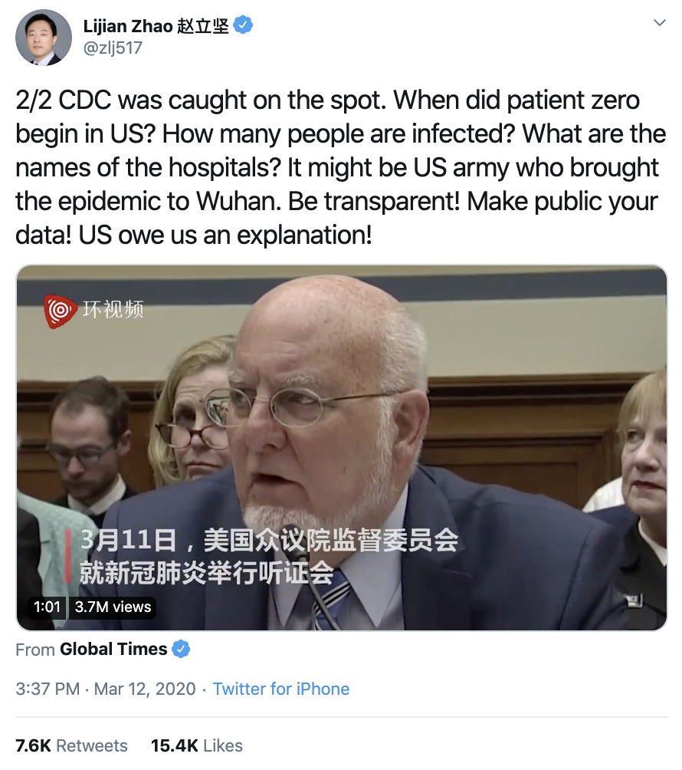
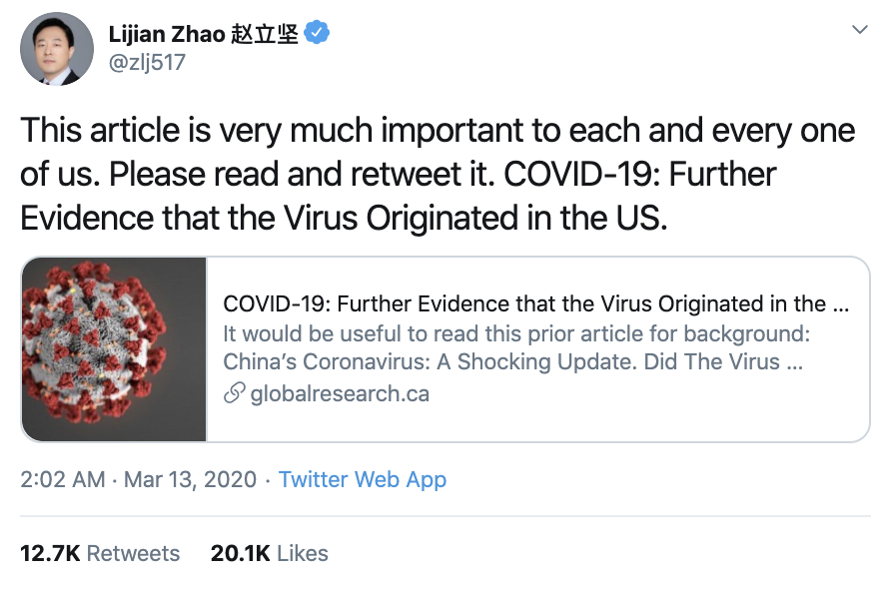
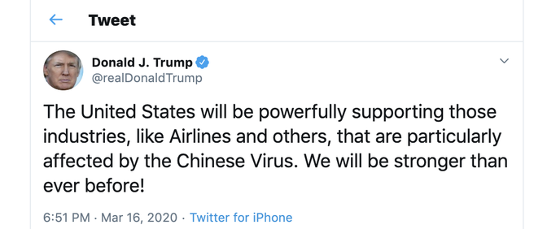
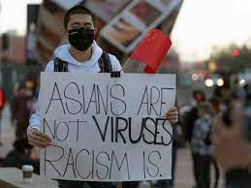
Which fallacy is it?
Notes:
https://fsi.stanford.edu/news/china-covid19-origin-narrative

Slide 43
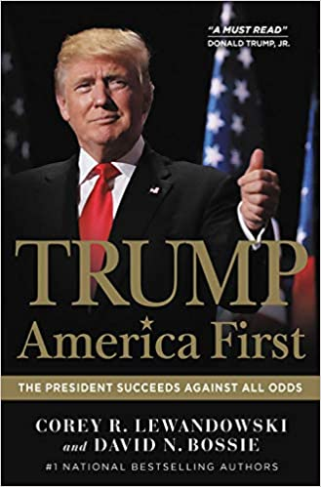
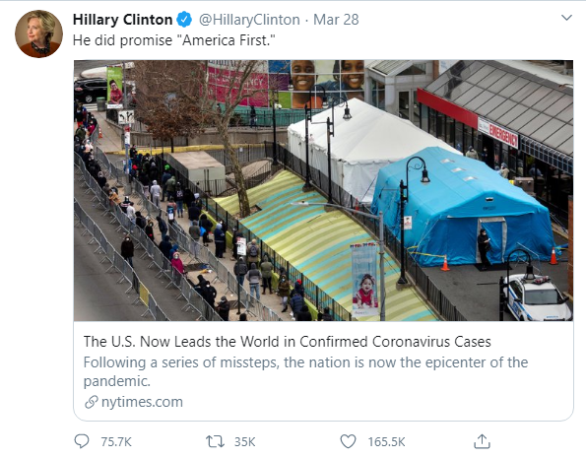
Which fallacy is it?

Slide 44
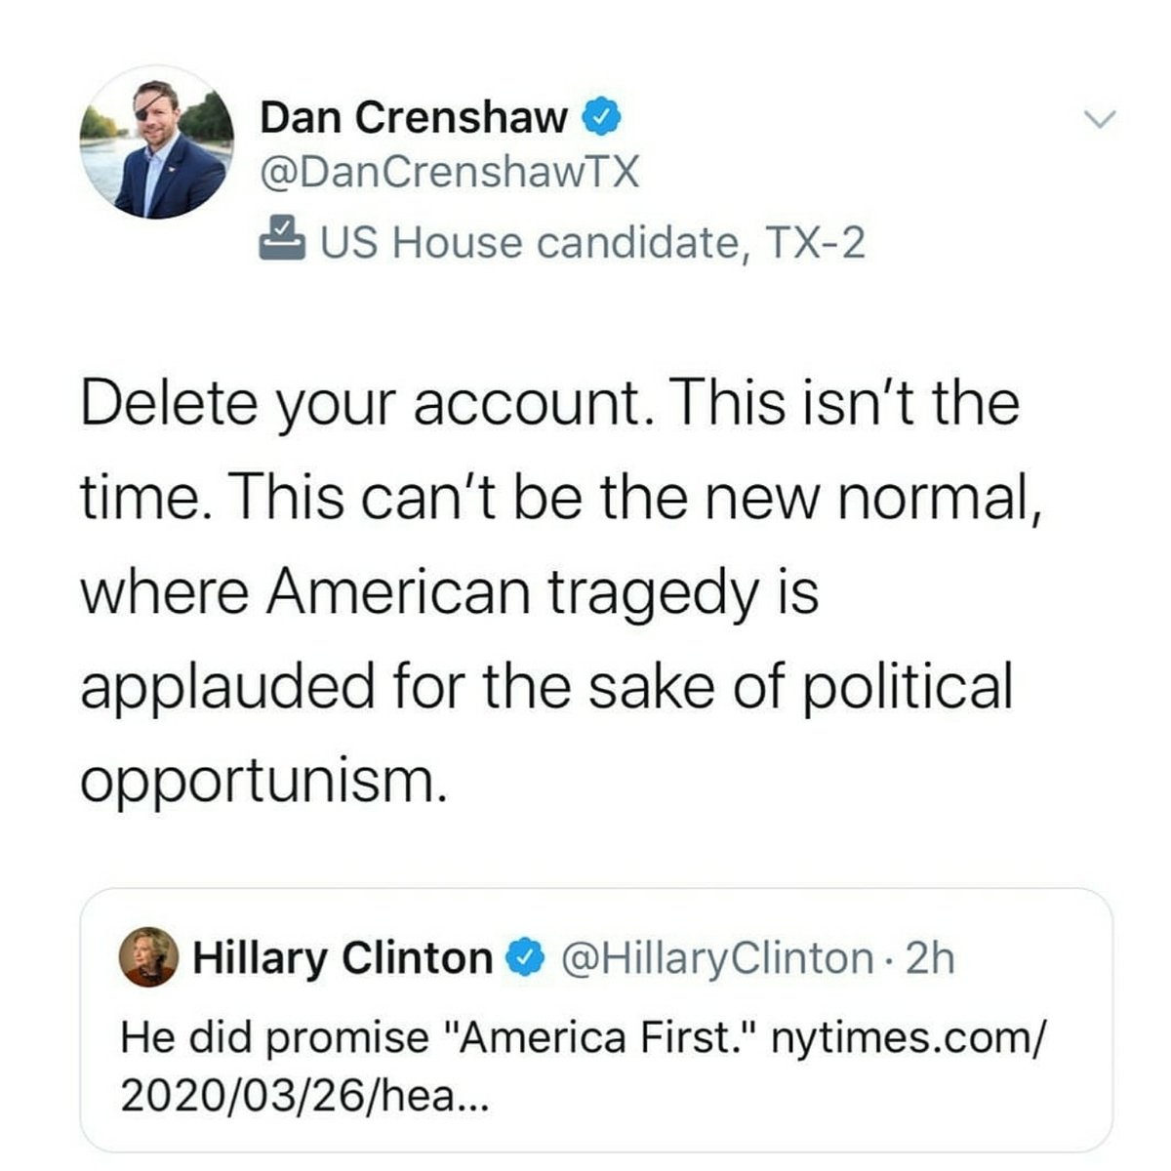
Which fallacy is it?

Slide 45
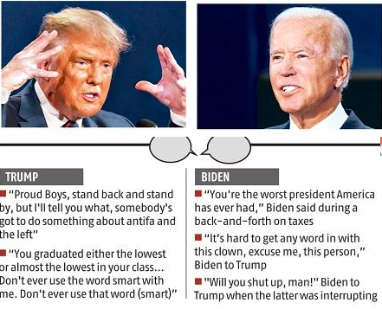
Which fallacy is it?
Notes:
https://www.business-standard.com/article/international/trump-versus-biden-yelling-shouting-as-chaos-reins-in-presidential-debate-120100100072_1.html

Slide 46
PRACTICE

Slide 47
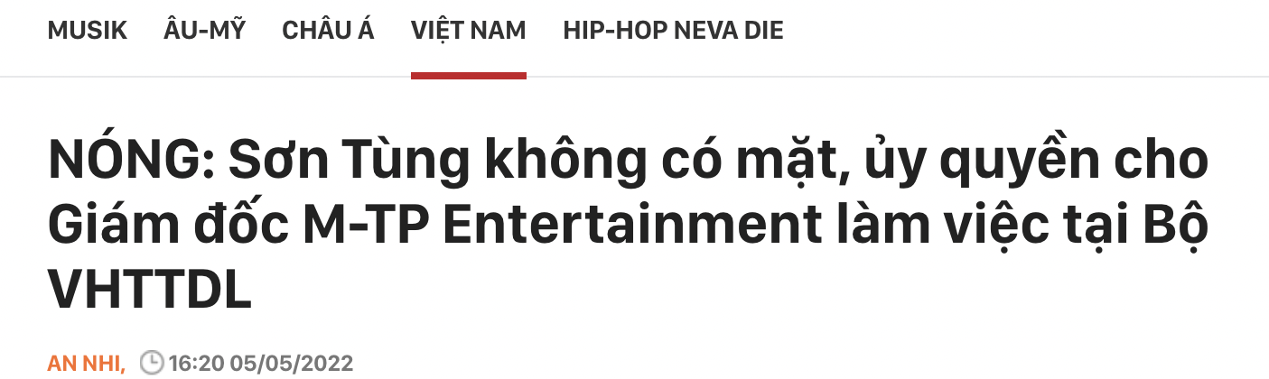
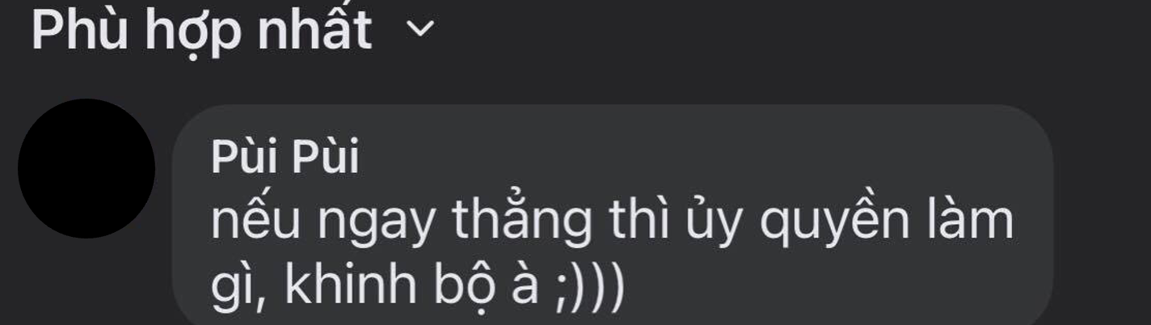
Student’s contribution
Fallacy type: Attacking motive
Source: https://www.facebook.com/K14vn/posts/5722411761114970

Slide 48
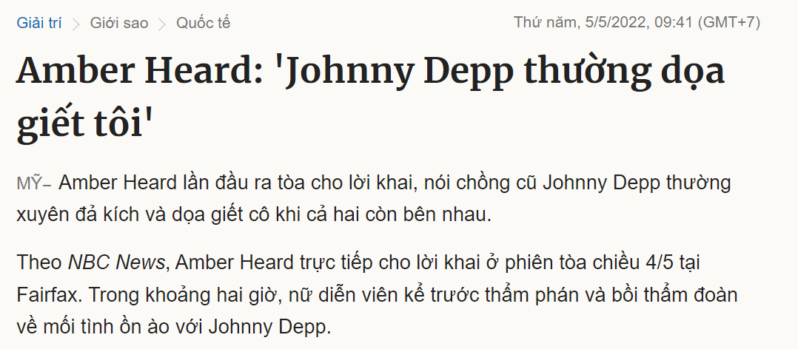

Student’s contribution
Fallacy type: Personal attack
Source: https://vnexpress.net/amber-heard-johnny-depp-thuong-doa-giet-toi-4459432.html

Slide 49


Student’s contribution
Fallacy type: Equivocation
Source: https://vnexpress.net/nhan-sac-nguoi-tinh-cua-cuu-chu-tich-taobao-4457839.html?fbclid=IwAR1BeEwWfLG6t5DbqUJLVXOzagHqMnBe6Ipl2dFtQ8ToKO8kdFFOHAulOcw
Notes:
1.Nguyễn Ngọc Phương Anh + BABAIU21340 2. Nguyễn Thị Kim Anh - BABAIU21336 3. Đậu Trần Nguyệt Hân - BABAIU21383 3. 4. Đặng Thảo Vi Anh – BABAIU21342 5. Trương Hoàn Mỹ - BTBCIU21054 6. Huỳnh Vũ Minh Đăng - BTBCIU21044 7. Nguyễn Trần Thiên Ân - BTBCIU21065 8. Võ Hoàng Phúc - BABAIU21152

Slide 50


Student’s contribution
Fallacy type: Personal attack
Source: https://www.youtube.com/watch?v=rDhx4ejrPPA&list=RDrDhx4ejrPPA&start_radio=1

Slide 51

Student’s contribution
Fallacy type: Scare tactic
Source: https://www.24h.com.vn/tin-tuc-trong-ngay/vu-thanh-nien-doa-csgt-tam-the-con-ong-chau-cha-len-dinh-c46a840194.html

Slide 52


Student’s contribution
Fallacy type: Personal attack
Source:https://www.facebook.com/photo/?fbid=533510641207572&set=gm.1526190961114830

Slide 53

Student’s contribution
Fallacy type: Bandwagon
Source: https://nld.com.vn/thoi-su-quoc-te/tuyen-bo-soc-cua-ga-chong-han-danh-vo-viet-gay-xuong-20190710120453288.htm

Slide 54







Fallacy type: Personal attack (Ad Hominem)

Slide 55

Student’s contribution
Bandwagon argument
Notes:
https://congan.vinhlong.gov.vn/tin-tuc/-/journal_content/56_INSTANCE_sJaRkI9m9m1g/10180/224227

Slide 56

Student’s contribution
Fallacy type: Straw man
Notes:
https://thanhnien.vn/nu-sinh-lop-8-tao-facebook-ao-vu-khong-thay-giao-ga-tinh-185230315093150141.htm

Slide 57

Student’s contribution

Slide 58
A fallacy or not a fallacy?
The new Volkswagon Beetle is the coolest car around. It’s selling like hotcakes. You should ask your parents to buy you one.
2. Jason: Did you hear Andrew’s class presentation on upper-class rights and privileges?
Kyle: Yeah, but I don’t take any ideas in his arguments. He’s just a rich snob who likes to hear himself talk.
Bill Baxter deserves to be promoted to vice president. He has three small children, and just last week his wife was diagnosed with breast cancer.
4. My driving instructor, Mr. Peterson, told me that it’s dangerous to drive
without a seat belt. But why should I listen to him? Last week I saw him driving without a seat belt.
5. Malcolm Cox isn’t qualiﬁed to be a kindergarten teacher. He’s lazy and
incompetent and has twice been convicted of child abuse.
Notes:
Key in your textbook

Slide 59
A fallacy or not a fallacy?
6. Jeff and Maribeth slept together on prom night. Sleep is a state of
unconscious or semiconscious rest or repose. It follows that Jeff and
Maribeth must have spent a very restful night together.
7. Martha is a good supervisor because she supervises the company's personnel office effectively.
8. Jesse Jackson has argued that last week’s police shooting was racially motivated. But this is exactly what you would expect Jackson to say. After all, he’s black.
9. Al: I can’t believe it! My bank made a mistake on my account balance.
There’s an extra $3,000 in my checking account.
Joe: Are you going to report the mistake?
Al: Why should I? They’ve been ripping me off for years with their high
ATM fees.
Notes:
Key in your textbook

Slide 60
A fallacy or not a fallacy?
10. My girlfriend asked me to do exercise with her. I I went running with her in the park. This morning she got zero for Math and got angry with me. How’s that possible?
11. People who watch little or no TV are generally more active than people who watch a lot of TV because the major networks send hidden messages to make people passive, sleepy, and wanting more TV.
12. Recently, a scientiﬁc study found that eating large amounts of chocolate
ice cream is actually good for you. We can’t accept this conclusion, however, because the study was funded entirely by Baskin-
Robbins and other leading ice-cream makers.
13. Only man has an immortal soul. No woman is a man. Therefore, no woman has an immortal soul.
Notes:
Key in your textbook

Slide 61
A fallacy or not a fallacy?
14. Mother to daughter: Nana was asking about you the other day. She’s so lonely and depressed since Grandpa passed away, and her Alzheimer’s seems to get worse every day. She’s done so much for you over the years. Don’t you think you should pay her a visit?
15. According to the song, the pinball wizard is deaf, dumb, and blind. Dumb people aren't very smart. So, the pinball wizard isn't very smart.
16. The Red Cross is worried about the treatment of the suspected terrorists held by the U.S. at Guantanamo Bay, Cuba. What do they want the U.S. to do with them, put them on the beaches of Florida for a vacation or take them skiing in the Rockies? Come on, let's worry about the Americans. (adapted from a newspaper call-in column)
Notes:
Key in your textbook

Slide 62
Assignment
Read some trending newspaper articles on the social media and the follow-up comments under them. Find at least FIVE fallacies in the articles (if any) and in the comments.
Link to submit:
https://forms.gle/gMzwX5o2kocbQwYG9
Note: Delete lesson slides; only keep the assignment slides.

Slide 63
Assignment
Text 1:
Fallacy type:
Source:

Slide 64
Assignment
Text 2:
Fallacy type:
Source:

Slide 65
Assignment
Text 3:
Fallacy type:
Source:

Slide 66
Assignment
Text 4:
Fallacy type:
Source:

Slide 67
Assignment
Text 5:
Fallacy type:
Source:

Slide 68
ATTENDANCE CHECK

Slide 69
Thank you

